Slide 1

It’s Me Parrot Rakhy

Slide 2
basic sys Python + DBMS machine learning data science web development video editing ai expert tools network access

Slide 3
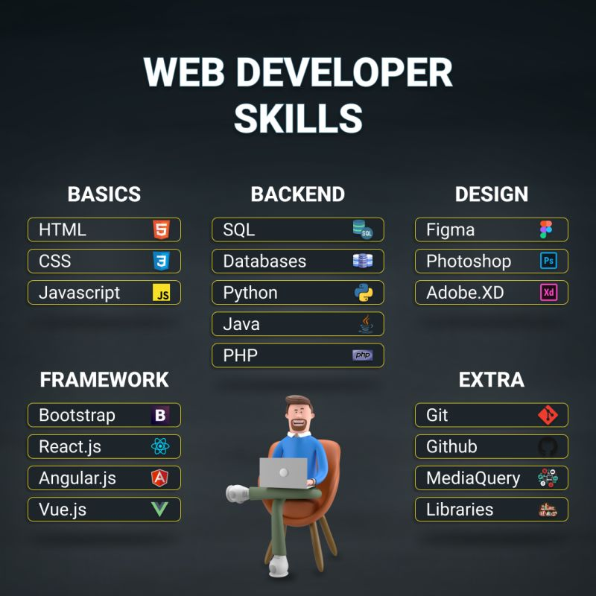

Slide 4
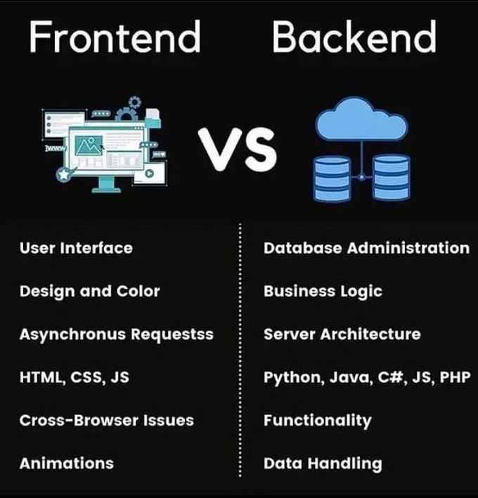

Slide 5
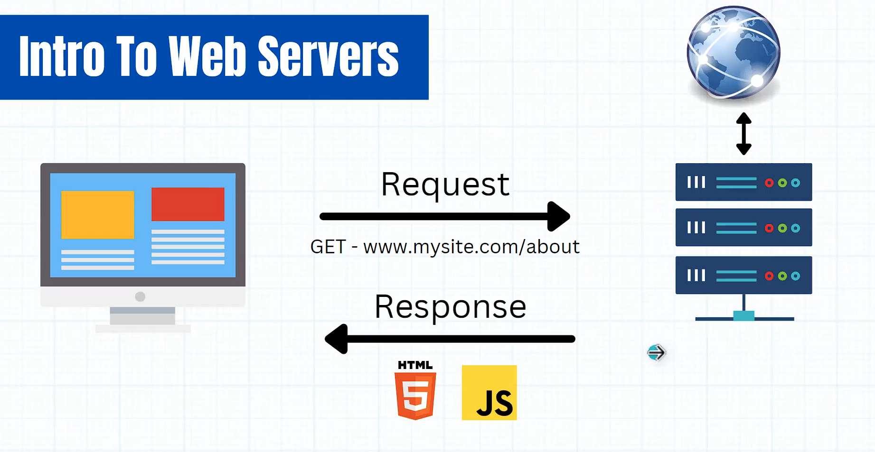

Slide 6
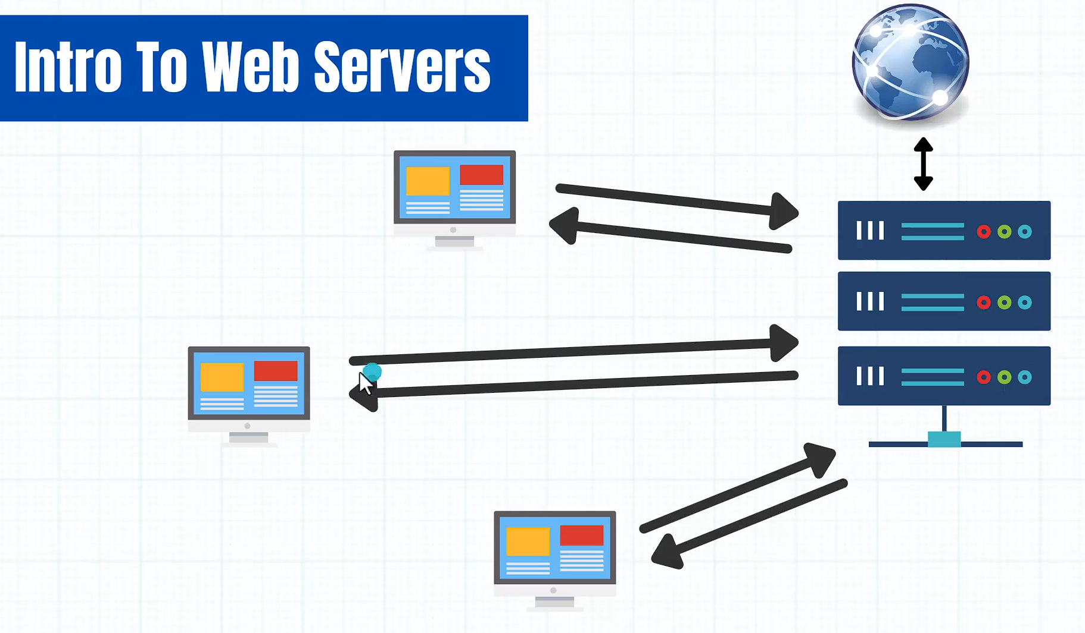

Slide 7
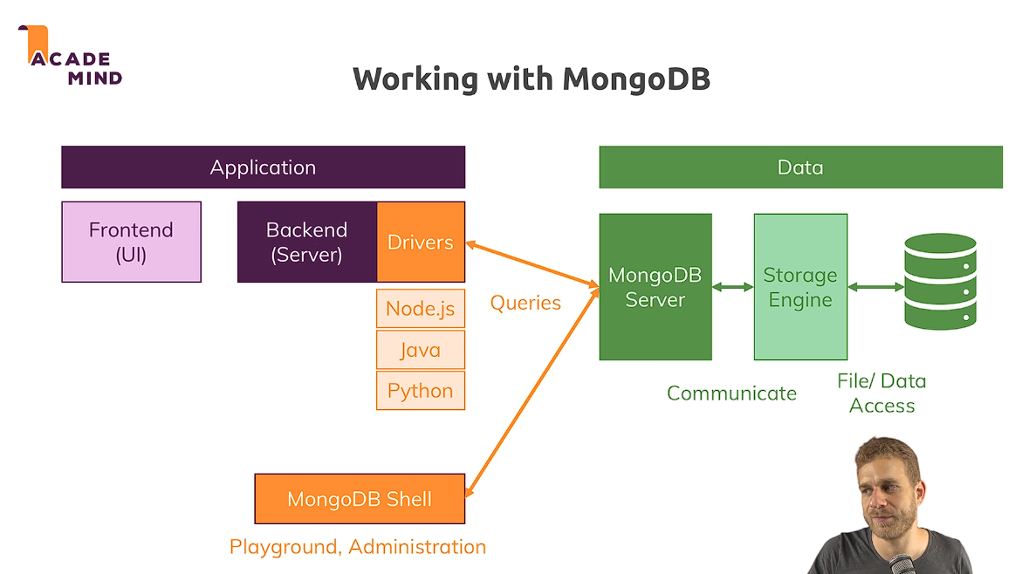

Slide 8
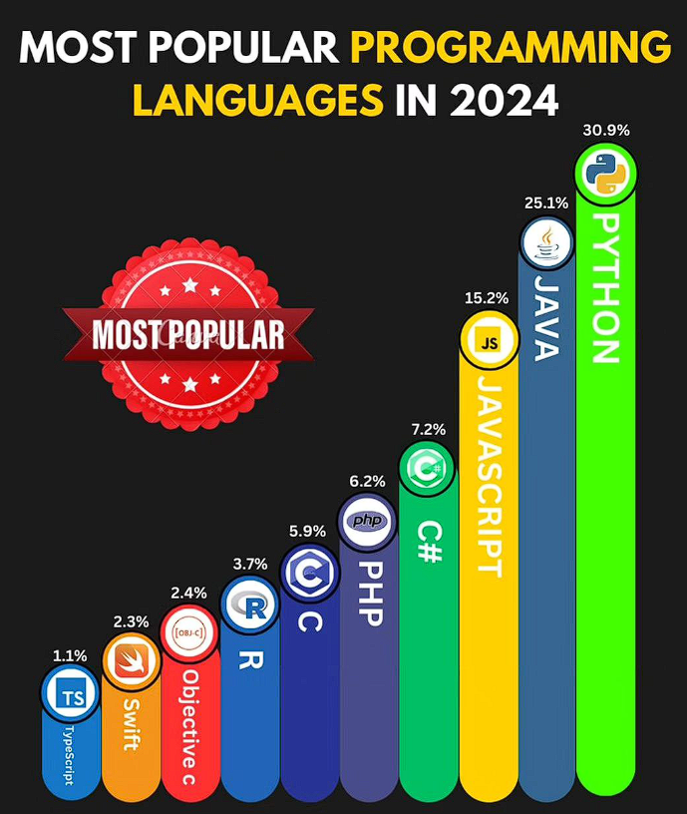

Slide 9
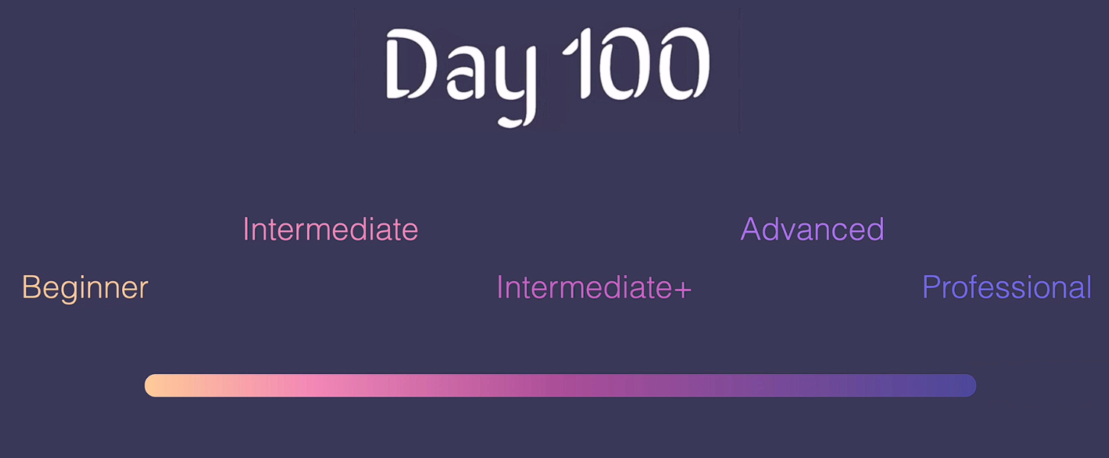

Slide 10
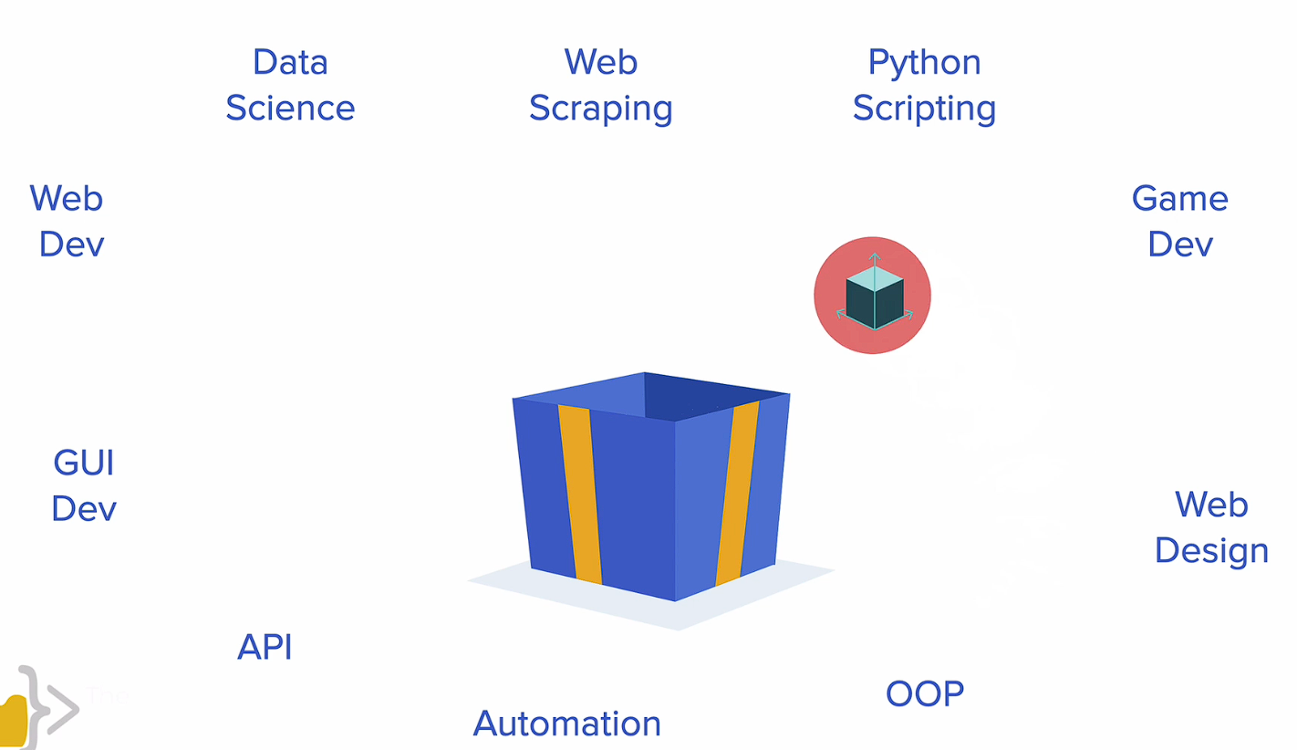

Slide 11
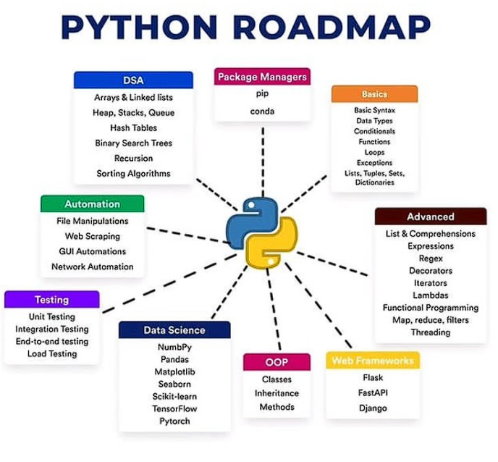

Slide 12
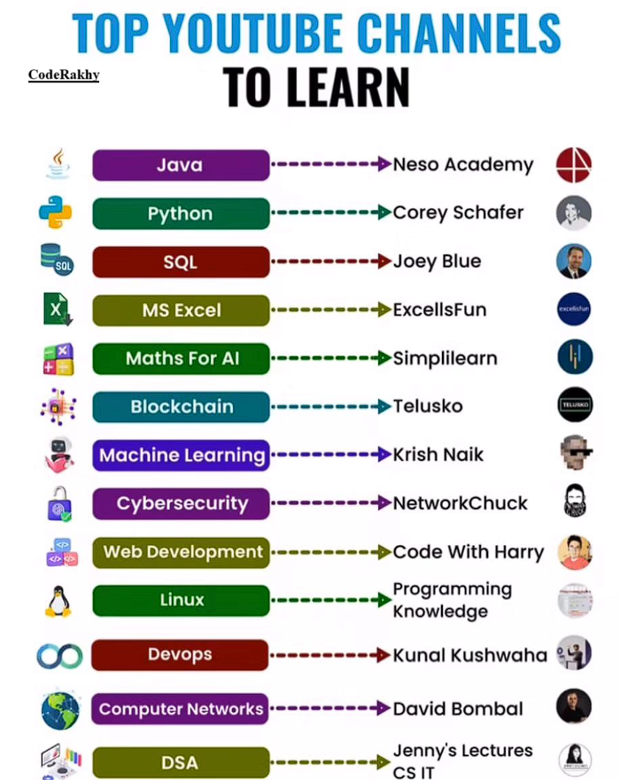

Slide 13
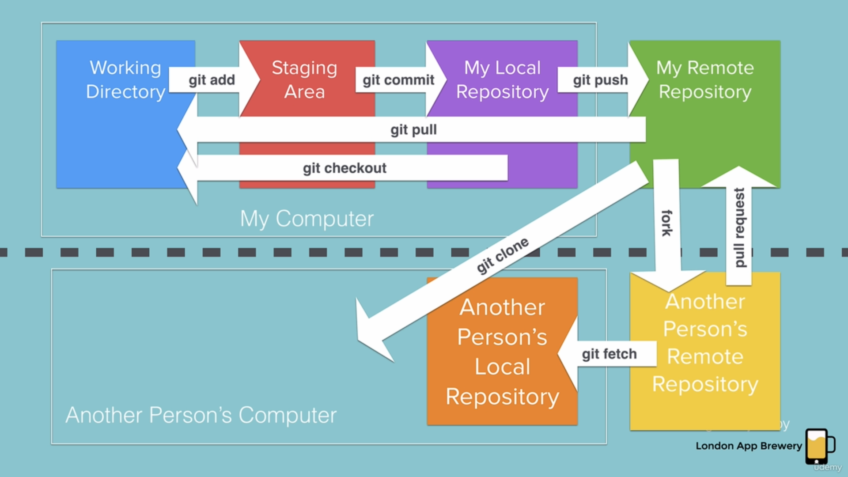
Git Commands

Slide 14
Ai tools

Slide 15
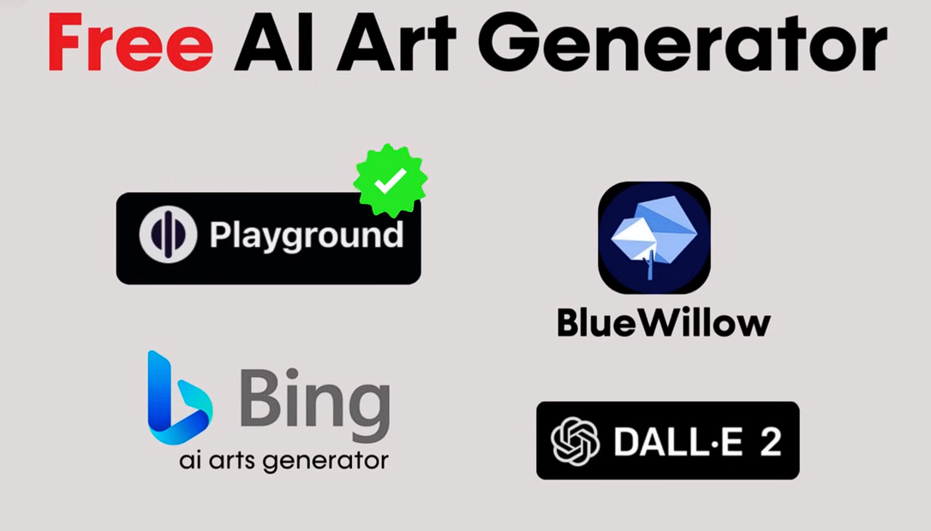

Slide 16


Slide 17
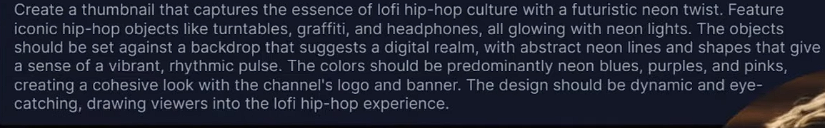
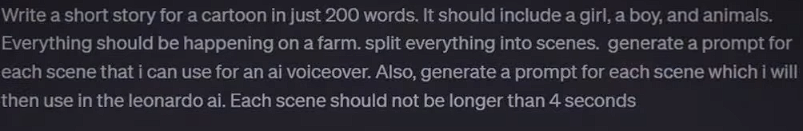
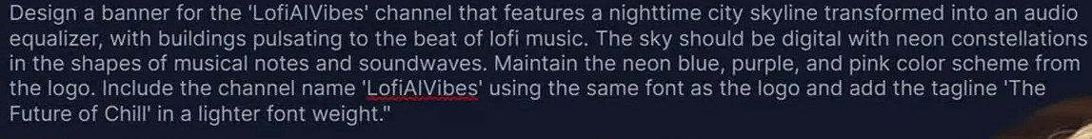
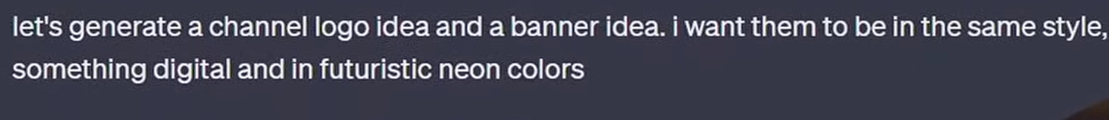
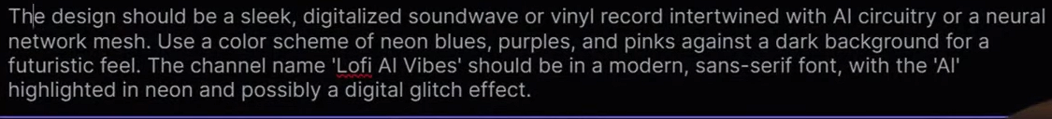
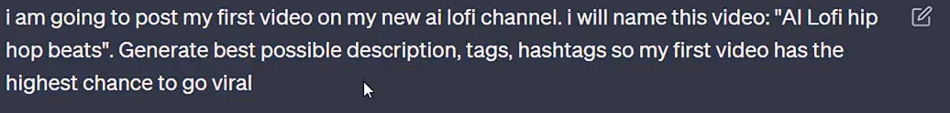

Slide 18
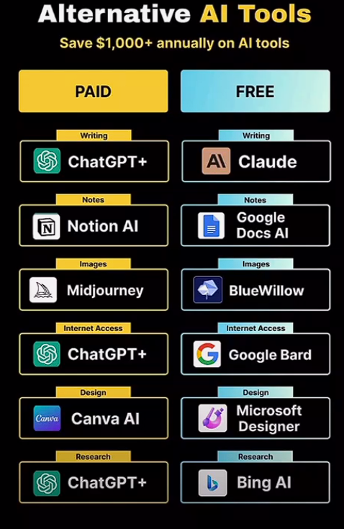

Slide 19
Tips & Tricks
Fake Emails
VPN security
Sharing Screens
Storing Data -- like Clouds
Searching Anyonmsoly – Tor Browser
Latest Updates related to AI and Stock or Financial related info etc. ( YT / Google)
Starting Your Business / YT Channel

Slide 20

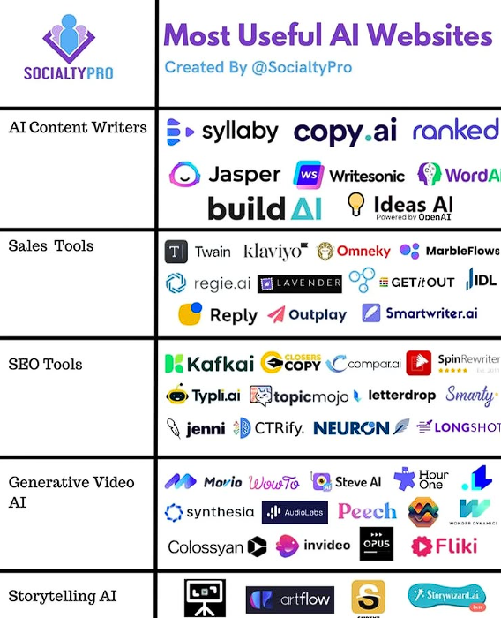
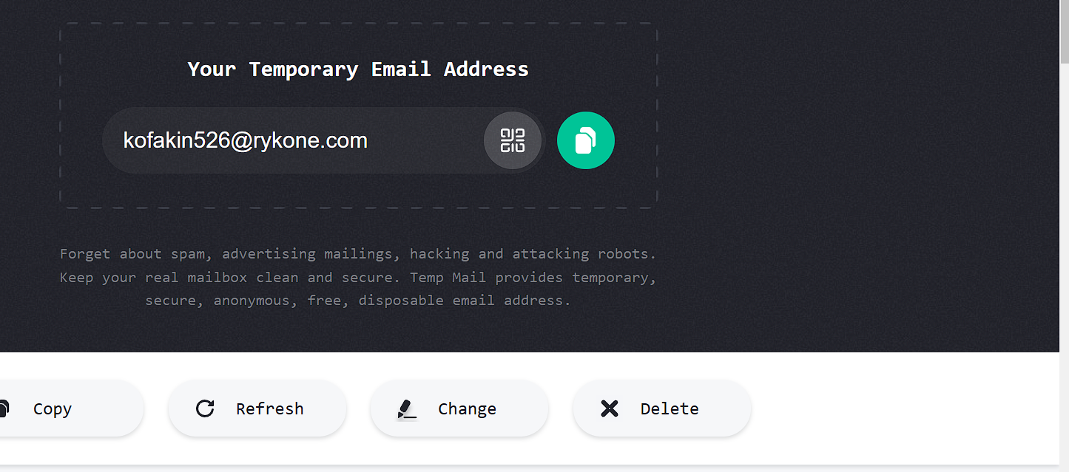





Slide 21
Resource links
If you feel like practicing your Python skills, check out these websites: https://codewars.com/
https://exercism.org/
https://leetcode.com/
https://hackerrank.com/
https://py.checkio.org/
https://www.codingame.com/

Slide 22
END

Slide 23
AI Tools
Day 1 – chatgpt ( ask anything you want)
Day 2 – suno.ai ( for music)
Day 3 -- lenoardo.ai ( for Image generating)
Day 4 – gamma.app ( for ppt presentations using AI)

Slide 24
Network & privacy tricks
Temporay Emails --- https://temp-mail.org/en/
Check your email is secure ---- https://haveibeenpwned.com/
typing test ---- https://keybr.com

Slide 25
Beginner’s level Starts from here

Slide 26
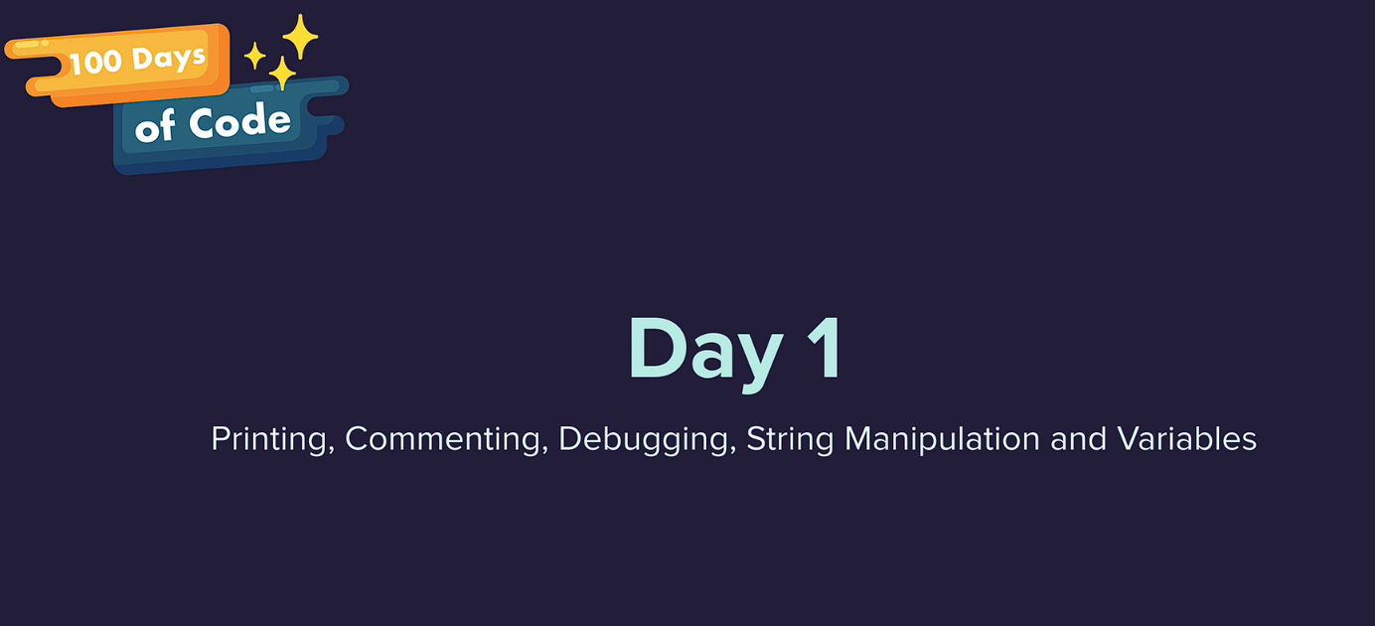

Slide 27
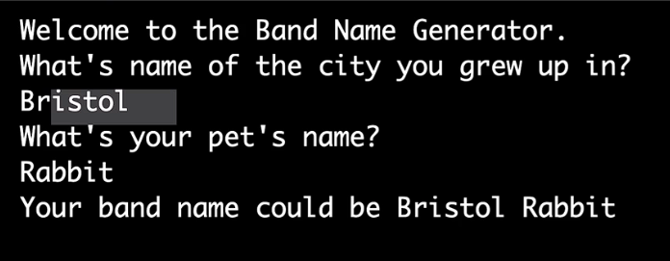
Day – 1 Project

Slide 28
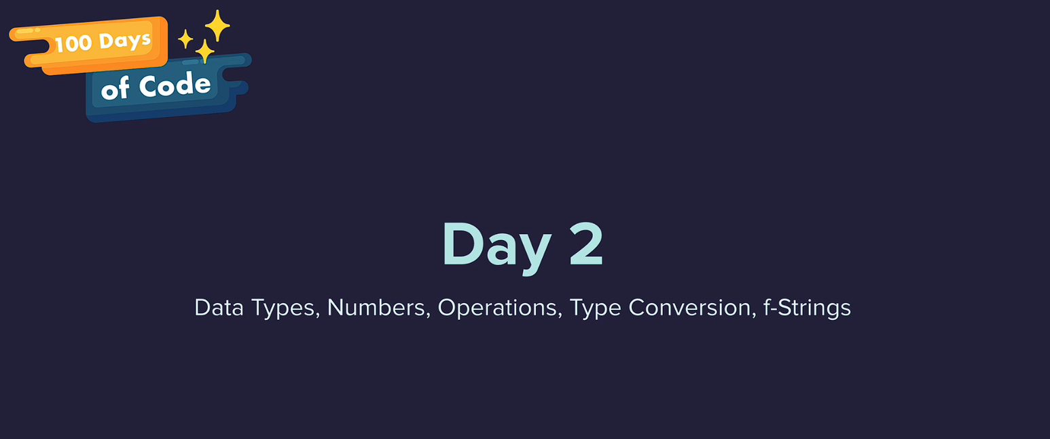

Slide 29
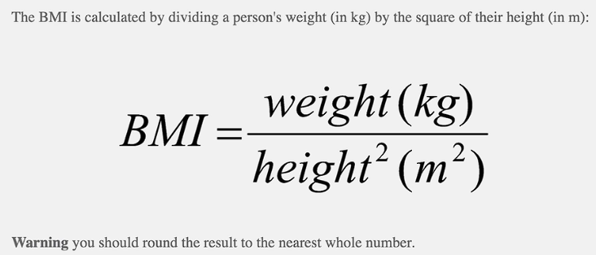
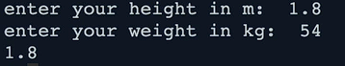
task

Slide 30
Task

Slide 31
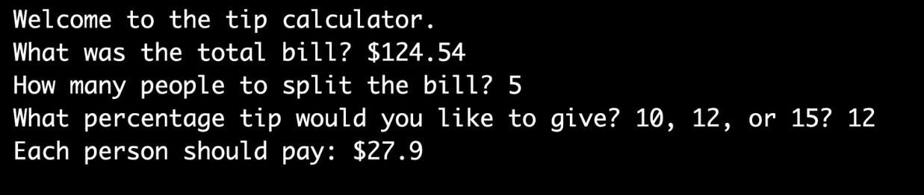
Day – 2 Project

Slide 32
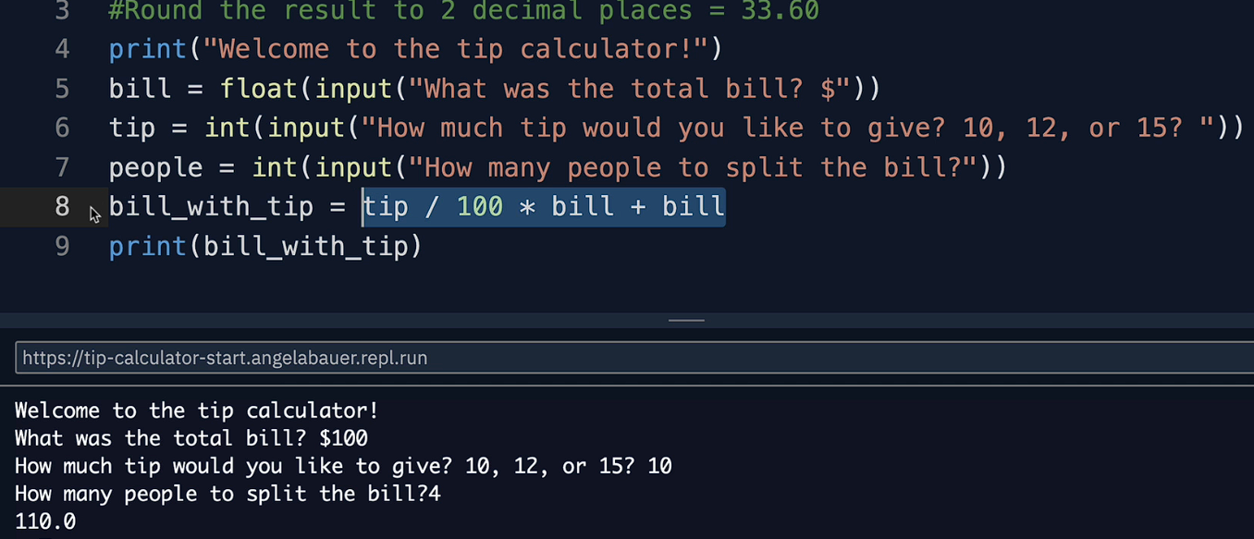
Solution

Slide 33
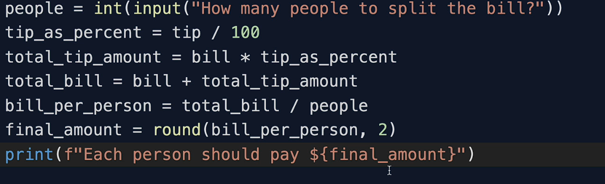
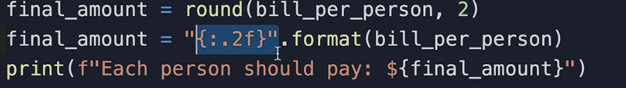
Another way solution - project 2

Slide 34
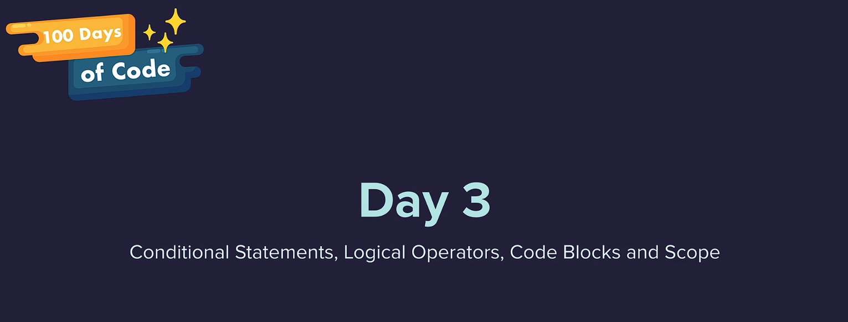

Slide 35
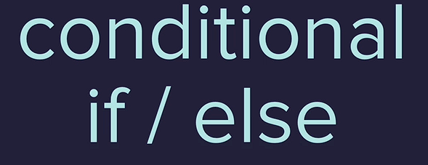
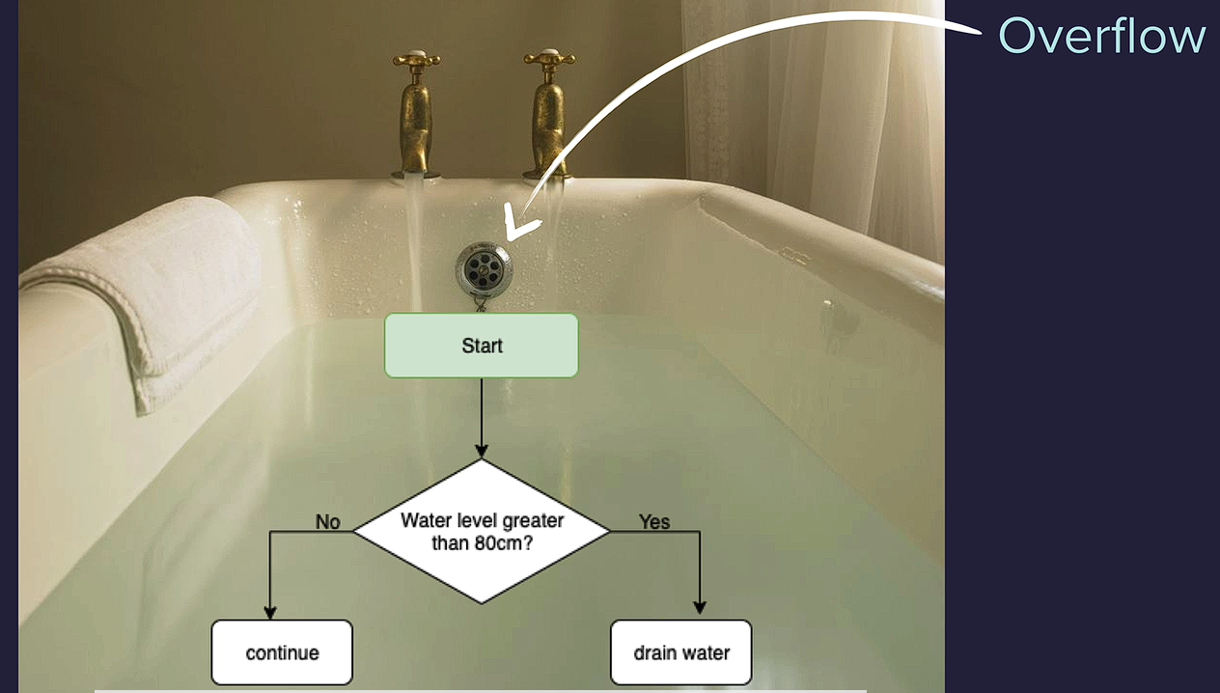
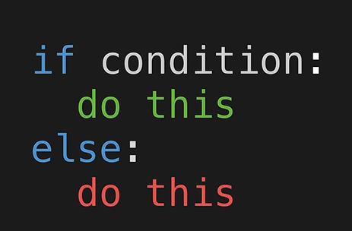

Slide 36
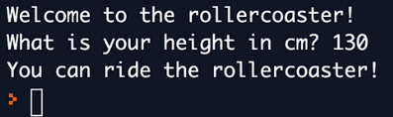
Task

Slide 37
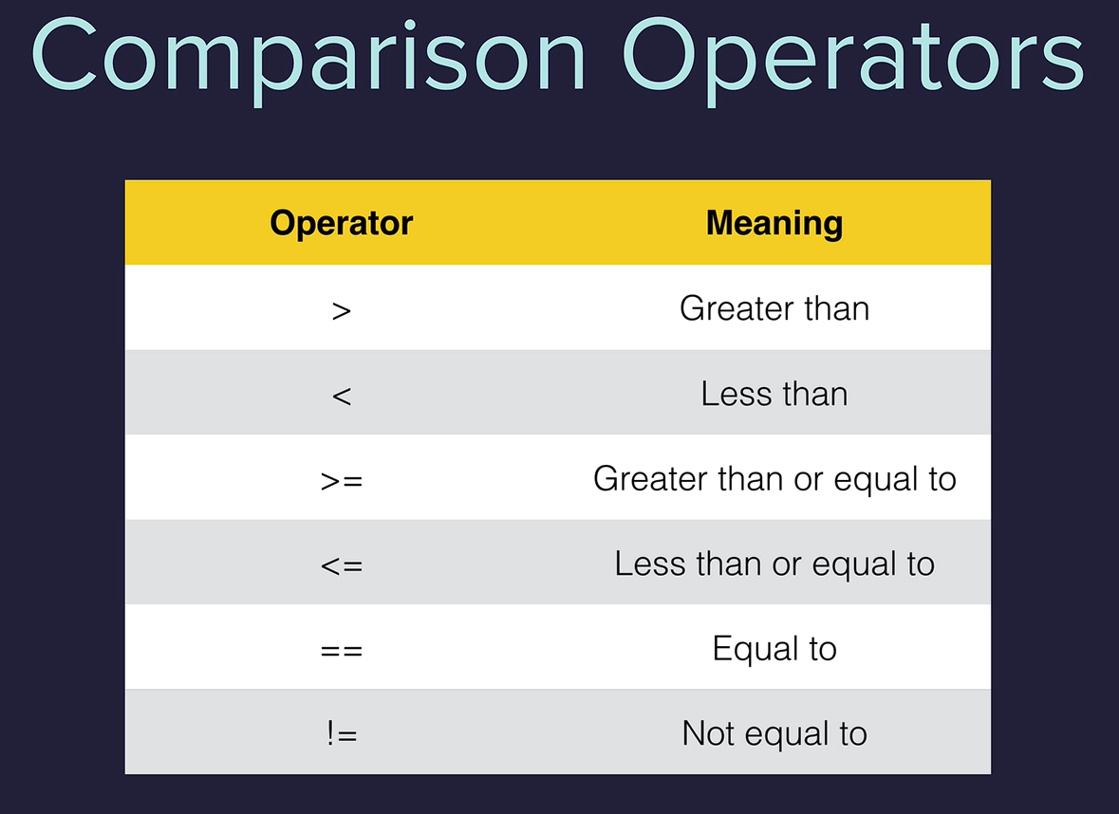

Slide 38
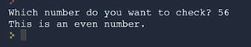
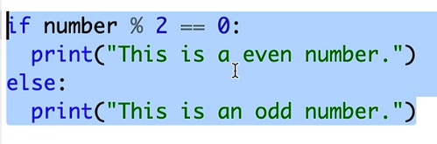

Slide 39
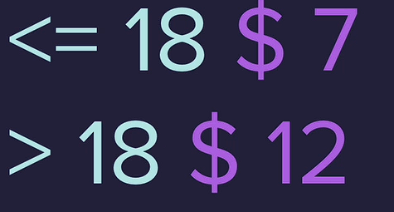
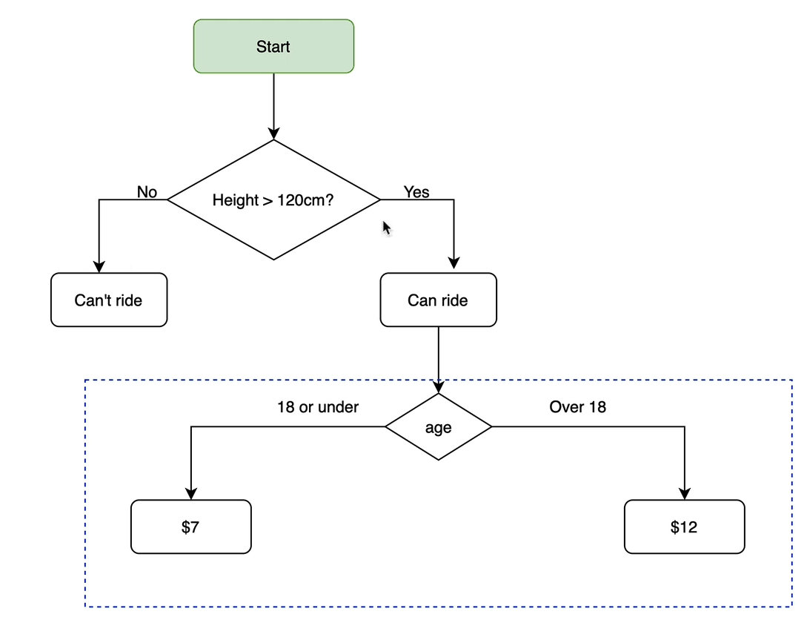
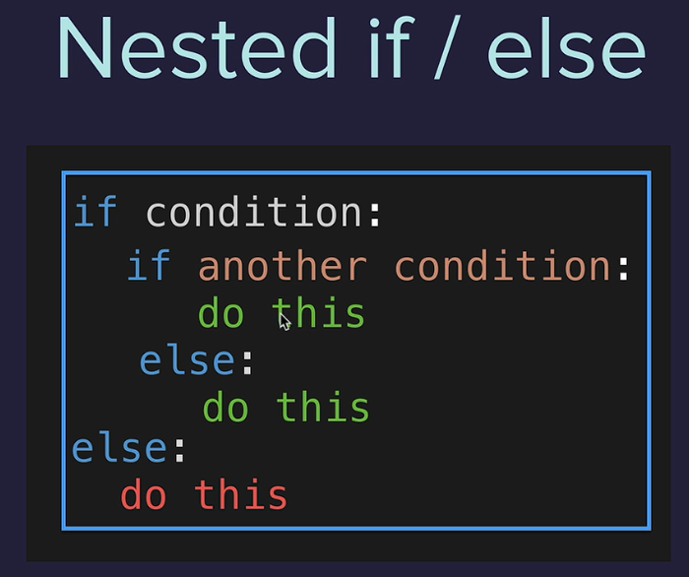
Nested if-else

Slide 40
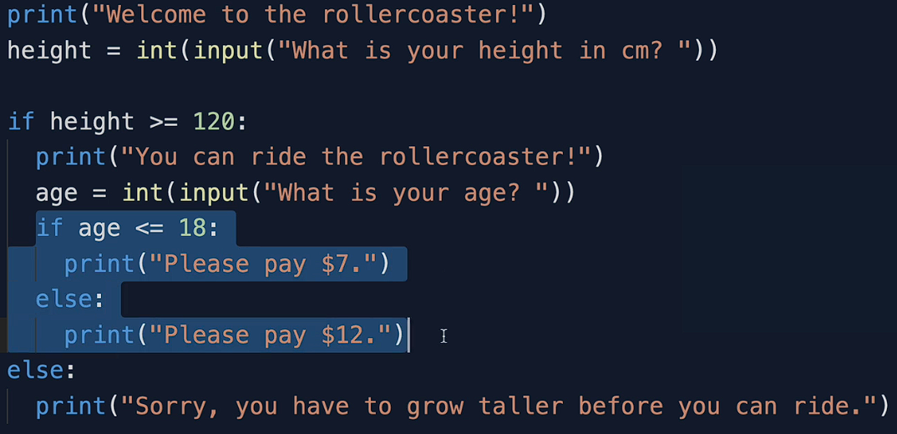
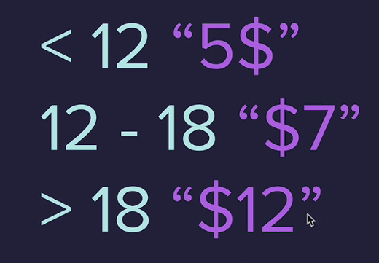
solution

Slide 41
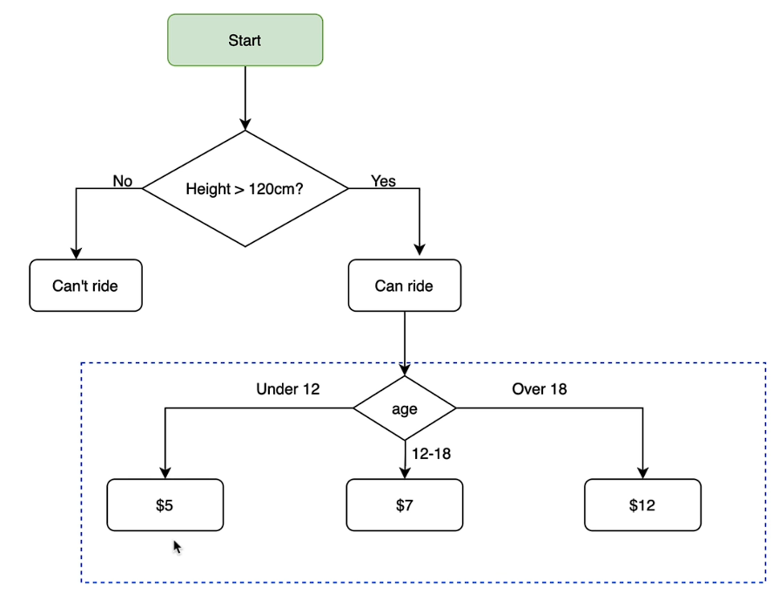
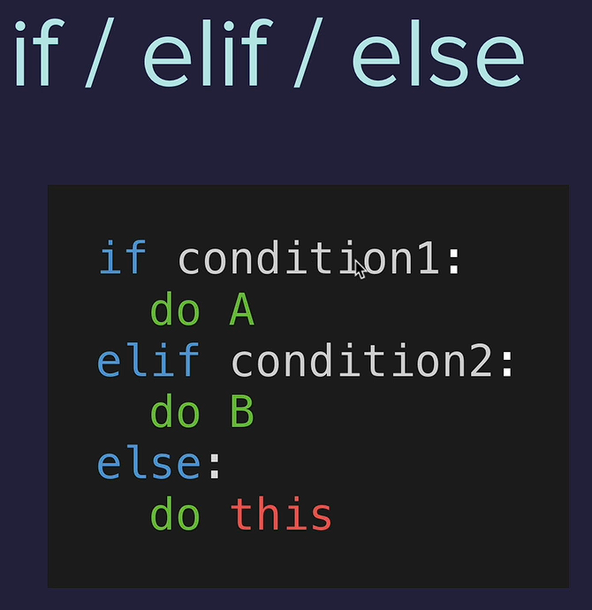

Slide 42
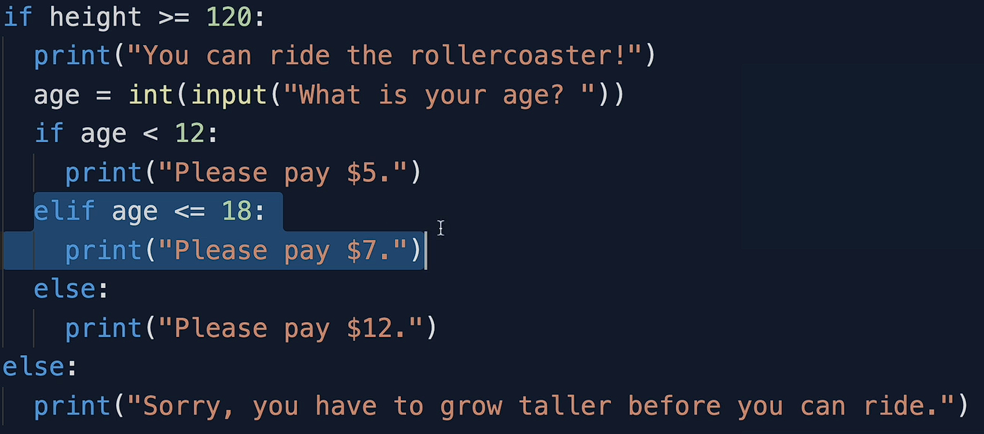
Solution

Slide 43
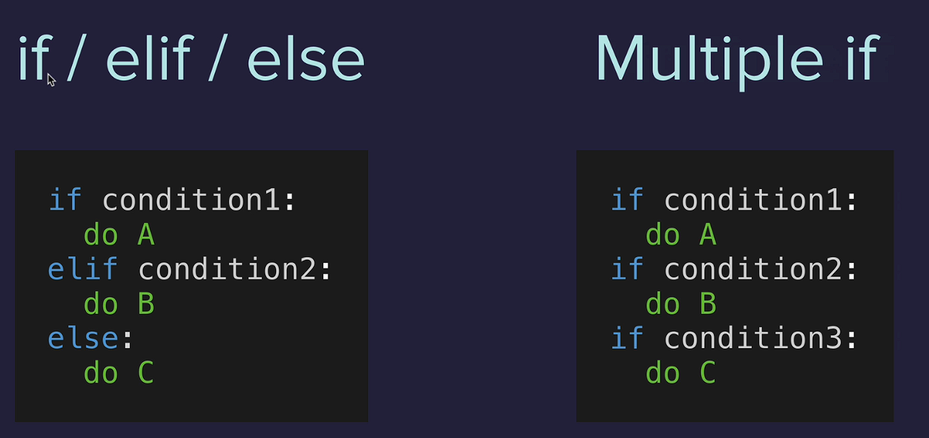
Multiple if conditions

Slide 44
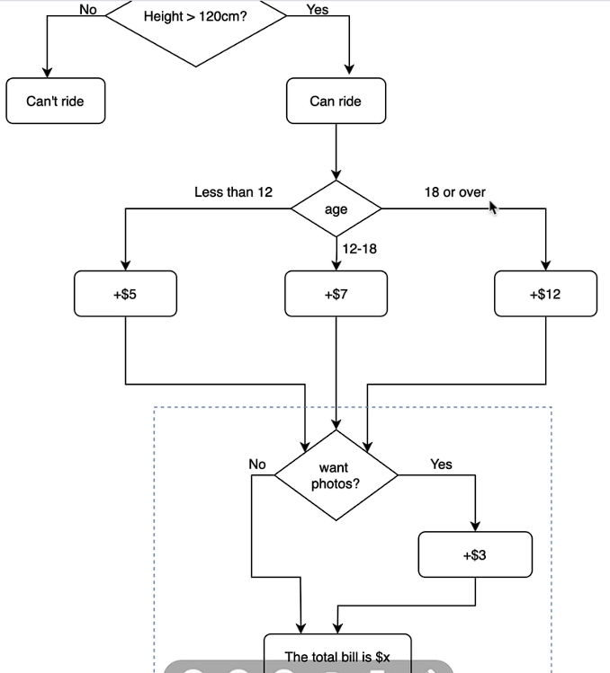
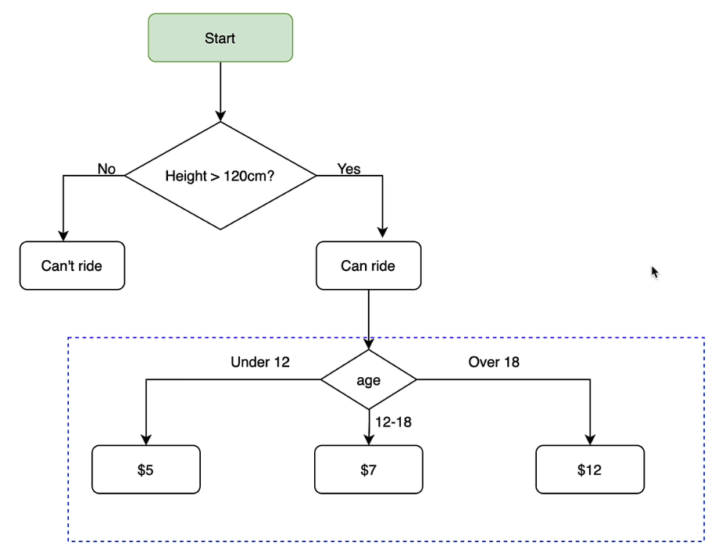
Task (Ticket pricing)

Slide 45
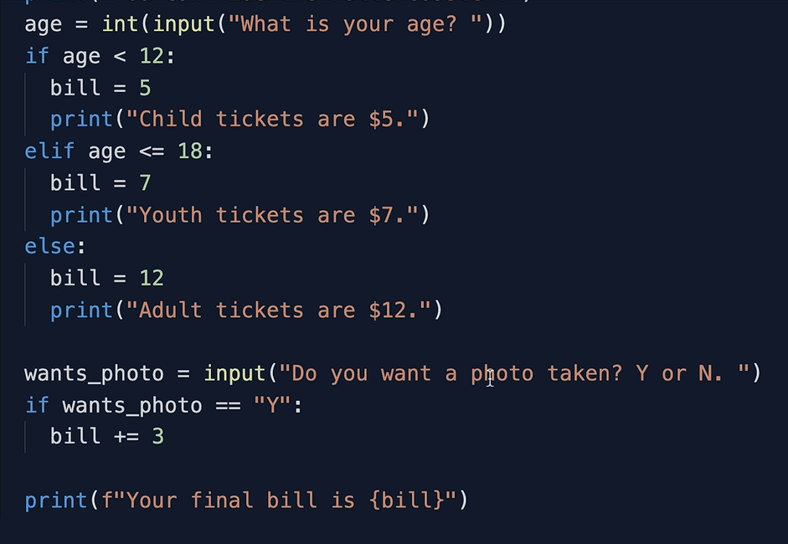


Solution / output

Slide 46


Task

Slide 47

Solution
(observe the seps flow using – thonny site)

Slide 48




Difficult Task

Slide 49


solution

Slide 50


Slide 51


solution

Slide 52



Logical Operators

Slide 53

Task

Slide 54



Slide 55



Hint & output

Slide 56


Solution

Slide 57


Day – 3 Project

Slide 58

Algorithm ( flow-chart)

Slide 59


Solution

Slide 60


Slide 61

Random numbers (import random)

Slide 62

Task

Slide 63

Data structures
Lists

Slide 64

String method

Slide 65

Nested lists

Slide 66



Day – 4 Project

Slide 67


Solution

Slide 68


Coding == gym

Slide 69


Slide 70



Slide 71


Solution

Slide 72

Actual way of writing solution

Slide 73


Slide 74



Slide 75

Solution ( 2 methos )
Method 1
Method2

Slide 76


Slide 77


Slide 78




Slide 79

solution

Slide 80


Project 5 – (Password generator)

Slide 81



Hint

Slide 82



solution

Slide 83
For else & patterns

Slide 84


Slide 85


Slide 86

Functions

Slide 87


Slide 88


Slide 89
Robot maze code game
https://reeborg.ca/reeborg.html?lang=en&mode=python&menu=worlds%2Fmenus%2Freeborg_intro_en.json&name=Maze&url=worlds%2Ftutorial_en%2Fmaze1.json

Slide 90


While loop
https://reeborg.ca/index_en.html

Slide 91


Slide 92


Slide 93


Slide 94


Slide 95




When to use for loop / while loop

Slide 96

Task ( hurdle – 3)

Slide 97

solution

Slide 98


Slide 99

Task ---------- Hurdle - 4

Slide 100



Slide 101


Project (Maze) solving by robot

Slide 102



Slide 103


Slide 104


Slide 105

Project
Play here : https://thewordsearch.com/hangman/
https://en.wikipedia.org/wiki/Hangman_(game)

Slide 106



Slide 107


Slide 108

Break the code

Slide 109


Slide 110

Understand Flow chart & Code

Slide 111
Refer list/for in/range topics
https://developers.google.com/edu/python/lists#for-and-in

Slide 112

Solution (step by step)
Step 1:

Slide 113


Step 2:

Slide 114


Check if/else

Slide 115

While loop

Slide 116



Hangman images task

Slide 117


solution

Slide 118
Refer module
https://www.askpython.com/python/python-import-statement

Slide 119



Task 5

Slide 120



solution

Slide 121



Slide 122
Final solution (check this link)
https://repl.it/@appbrewery/Day-7-Hangman-Final

Slide 123


Slide 124


Slide 125



Slide 126


Slide 127


Task

Slide 128

Task 2 ----- > Prime number checker
Prime numbers are natural numbers that are divisible by only 1 and the number itself. In other words, prime numbers are positive integers greater than 1 with exactly two factors, 1 and the number itself. Some of the prime numbers include 2, 3, 5, 7, 11, 13, etc.
rime numbers are the natural numbers greater than 1 with exactly two factors, i.e. 1 and the number itself.

Slide 129



Slide 130

solution

Slide 131

Project

Slide 132


Slide 133


Slide 134




Slide 135


Solution

Slide 136


Slide 137


Slide 138


List and dictionaries inside Dictionary

Slide 139



Slide 140


Slide 141

Solution

Slide 142

Project

Slide 143


Slide 144


Flow 1

Slide 145

Flow 2

Slide 146

Final flow

Slide 147


Slide 148


Slide 149

Logic

Slide 150



Slide 151

Project

Slide 152

Solution

Slide 153


Slide 154


Slide 155


Slide 156


Slide 157


Slide 158


Slide 159

Projects with extra features (dry / modularization / looping)

Slide 160


Slide 161




Slide 162


Slide 163


Slide 164


Slide 165



Slide 166

output

Slide 167


Slide 168



Slide 169



Slide 170


Slide 171


Slide 172

https://repl.it/@appbrewery/blackjack-start

Slide 173


Flow chart

Slide 174


steps

Slide 175



Slide 176




Slide 177



Slide 178



Slide 179




Slide 181

Day 12

Slide 182


Slide 183





Slide 184




Slide 185



Slide 186


project

Slide 187

algorithm
Solution : https://repl.it/@appbrewery/guess-the-number-final#main.py

Slide 188


Slide 189


Slide 190






Slide 191


Slide 192


Slide 193


Slide 194


Slide 195


Slide 196
Beginner’s level successfully Completed

Slide 197
Intermediate level Starts from here

Slide 198
Web development Starts from here

Slide 199
Bootstrap

Slide 200
Web development + intermediate level Starts from here

Slide 201
Advanced level Starts from here

Slide 202
Final level Projects Starts from here

Slide 203
SQL

Slide 204
Site for practice: https://www.sql-practice.com/
Solution Video Link
https://www.youtube.com/watch?v=nYmoQ4r0DVw&ab_channel=BuildwithAkshit

